Slide 2

This is Stephen!

Slide 3

Stephen is a professional NBA player.

Slide 4
Most of the time, he performs brilliant on-court!

Slide 5
But sometimes, Stephen has a bad day…

Slide 6

He also uses Twitter a lot! Stephen follows every post he gets linked to.

Slide 7
And that are many!

Slide 8
But wait…

Slide 9

What if the tweets have an influence on how Stephen performs in his games?

Slide 10

Could there be a positive correlation between the sentiment of the tweets before a match and a player‘s on-court performance?

Slide 11
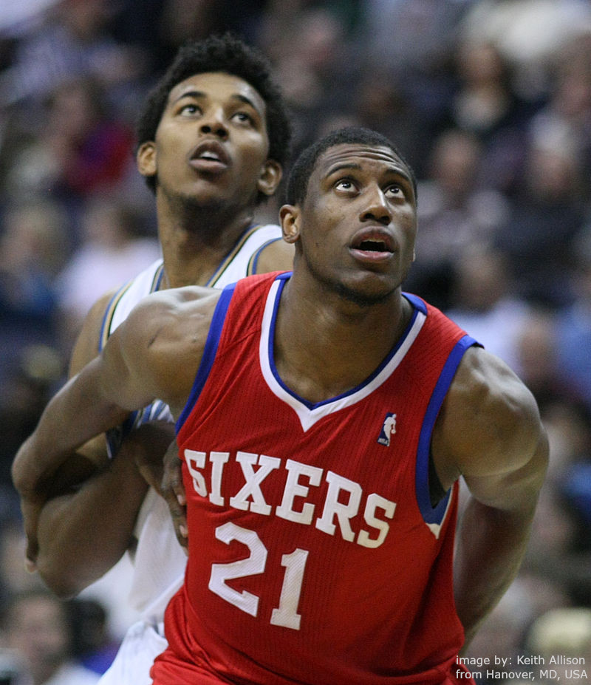
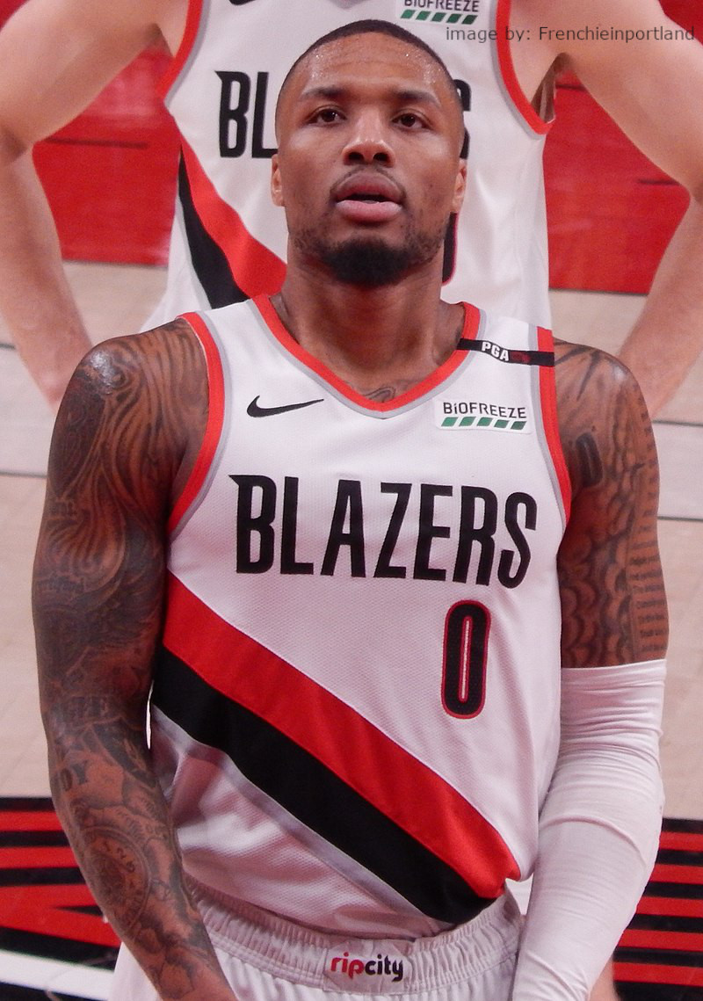
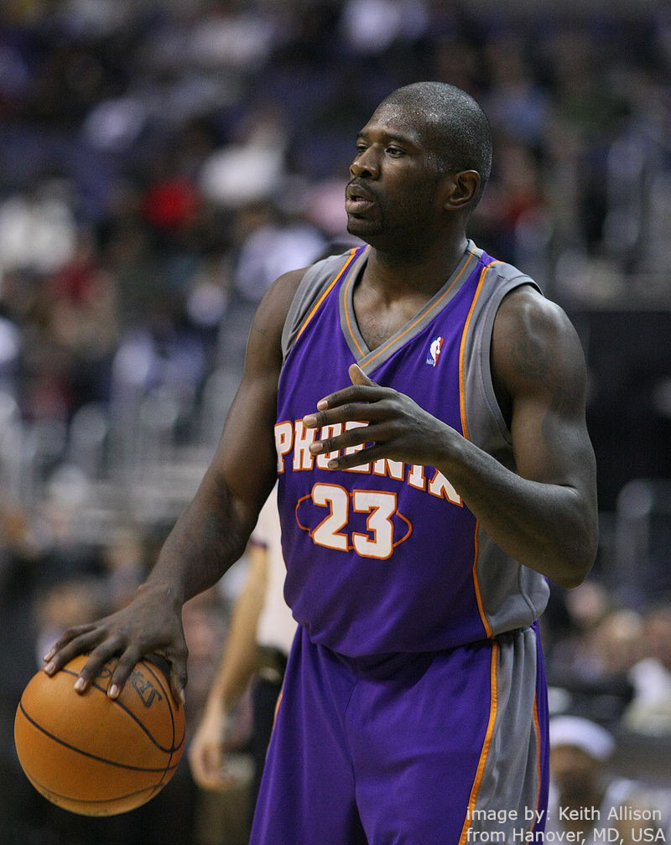
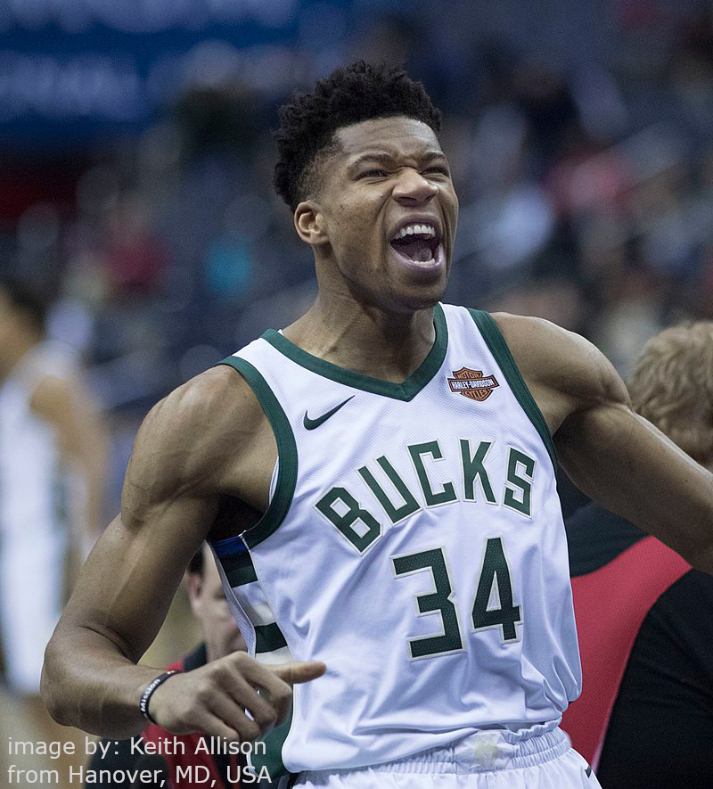
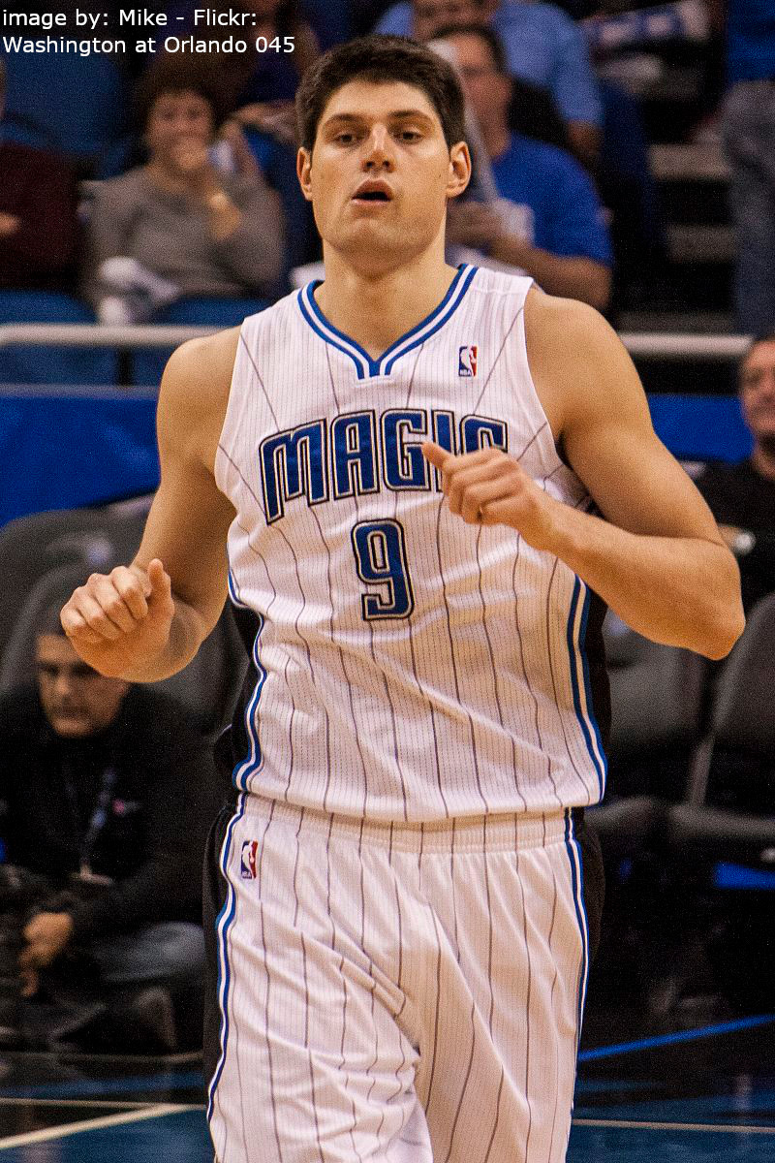
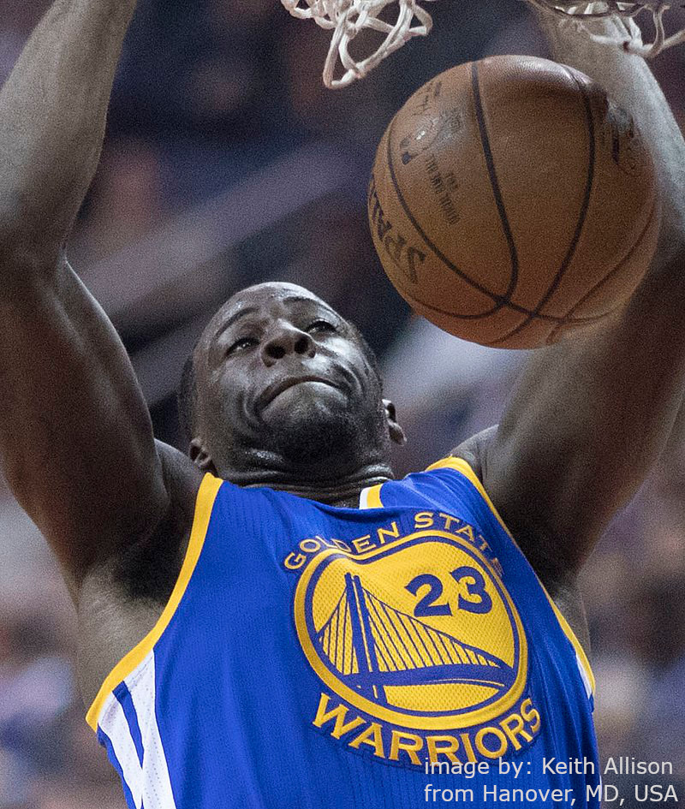
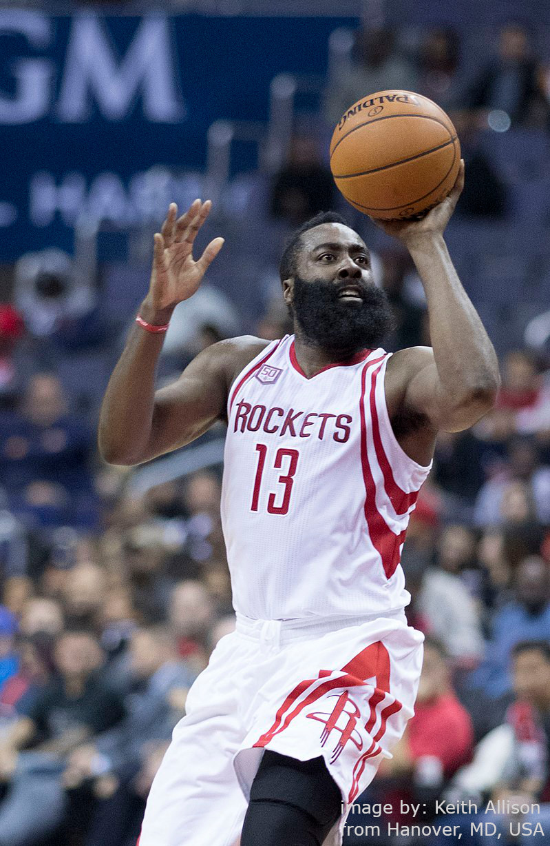
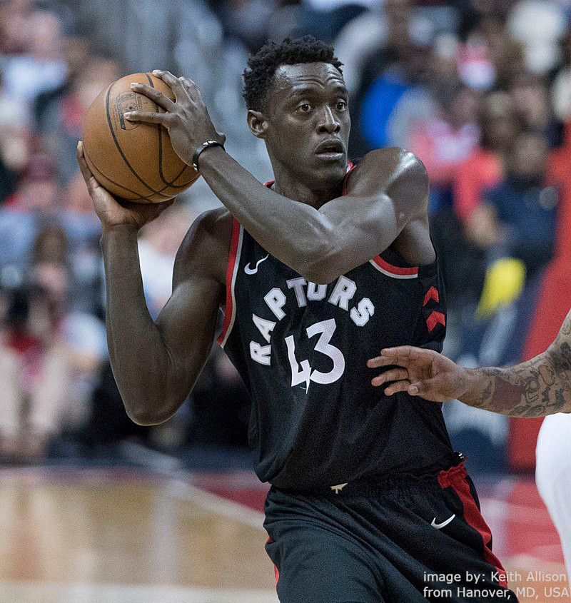
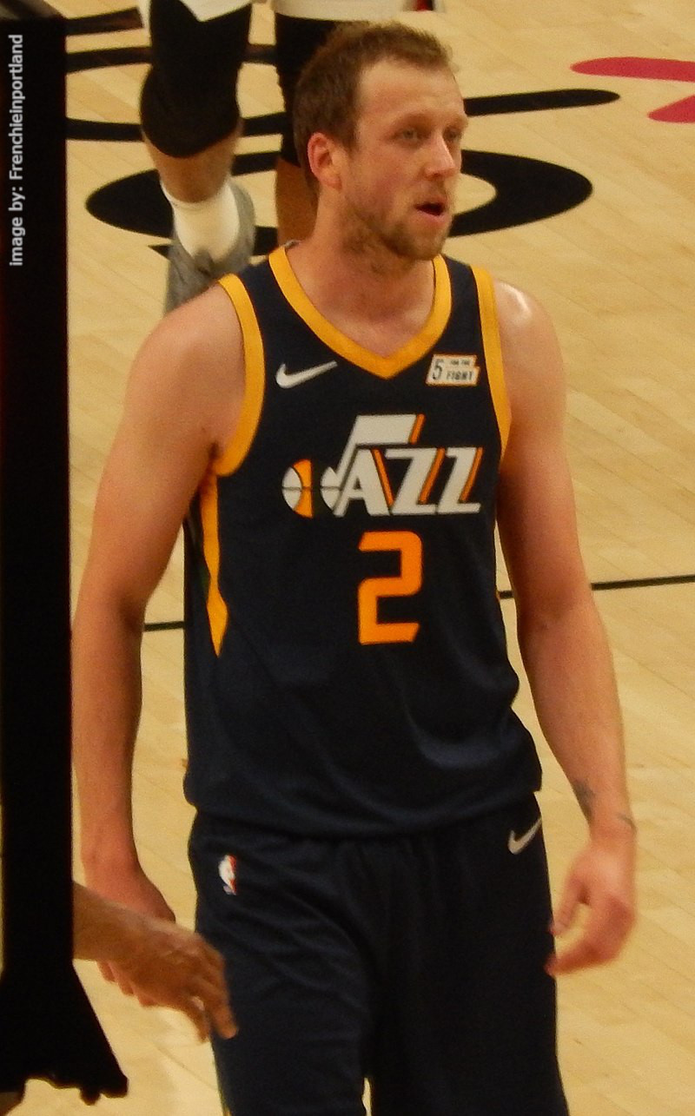
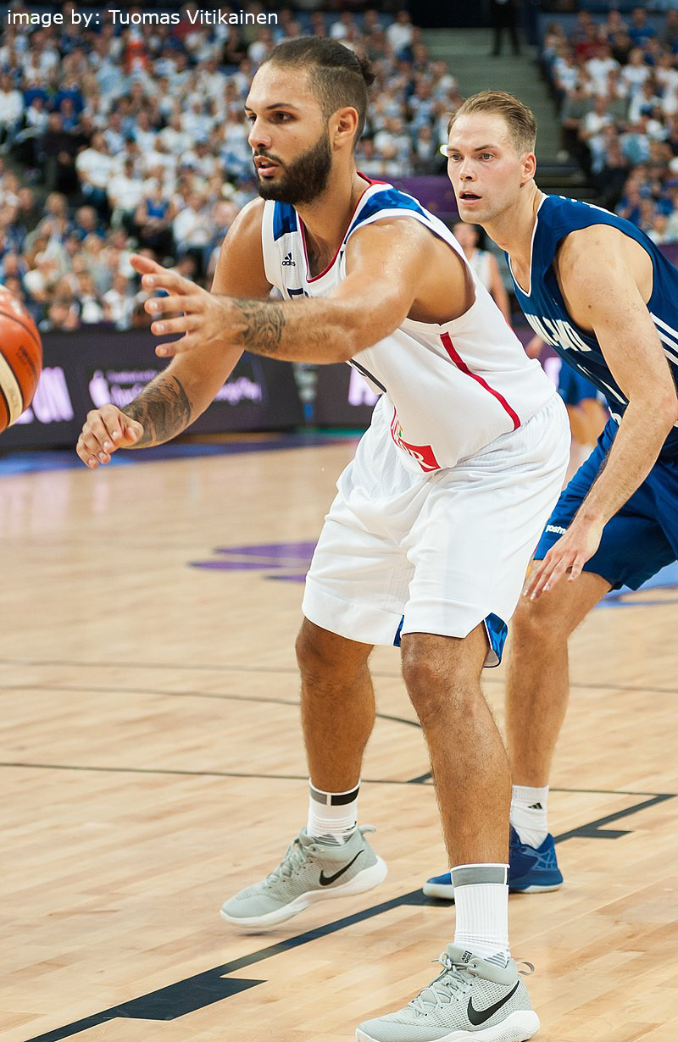
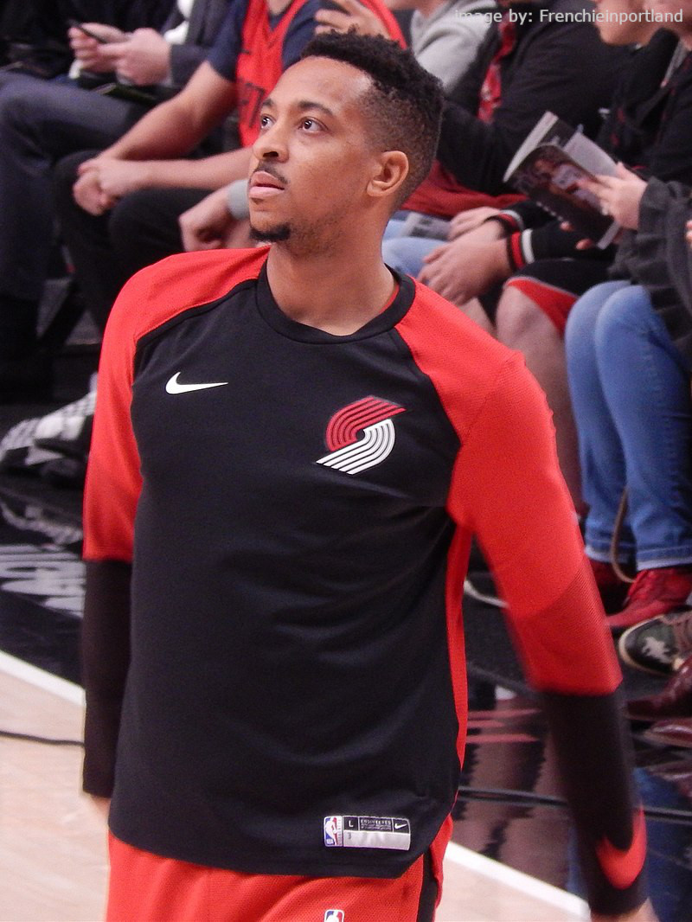
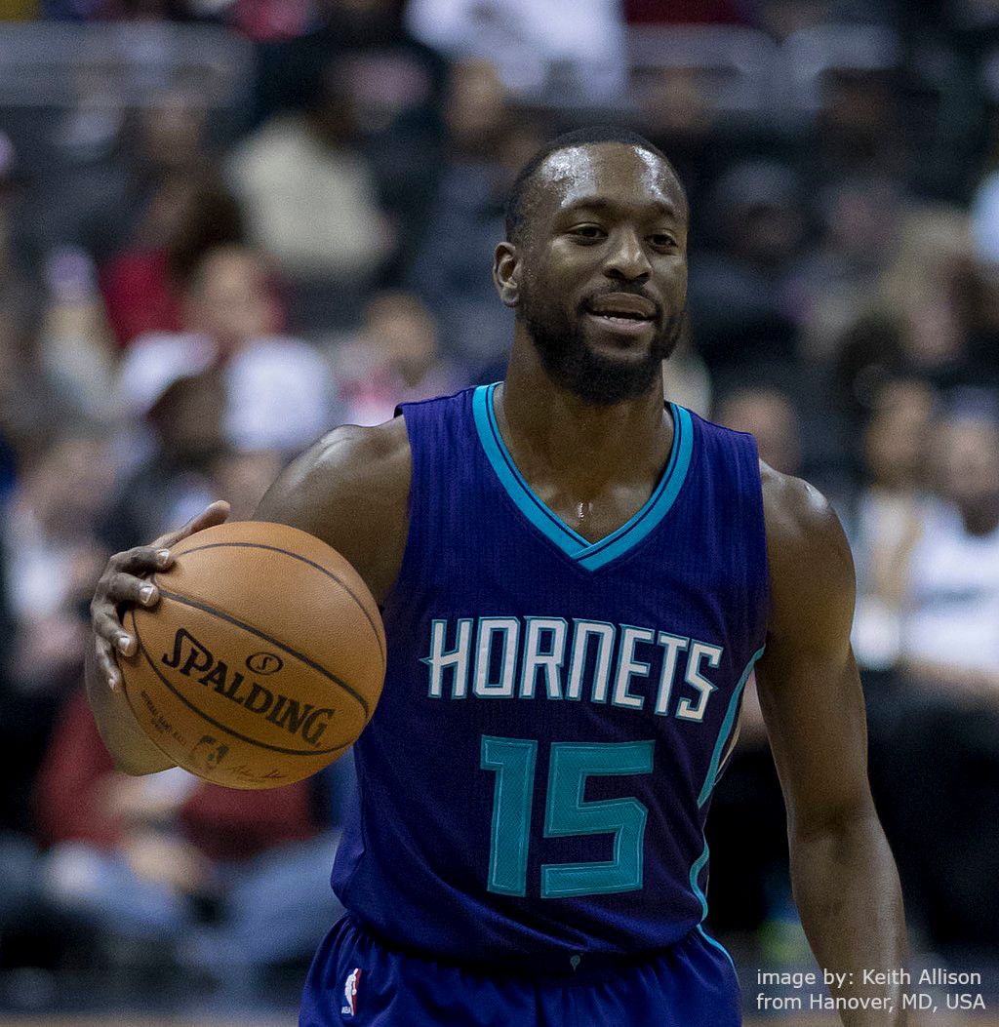
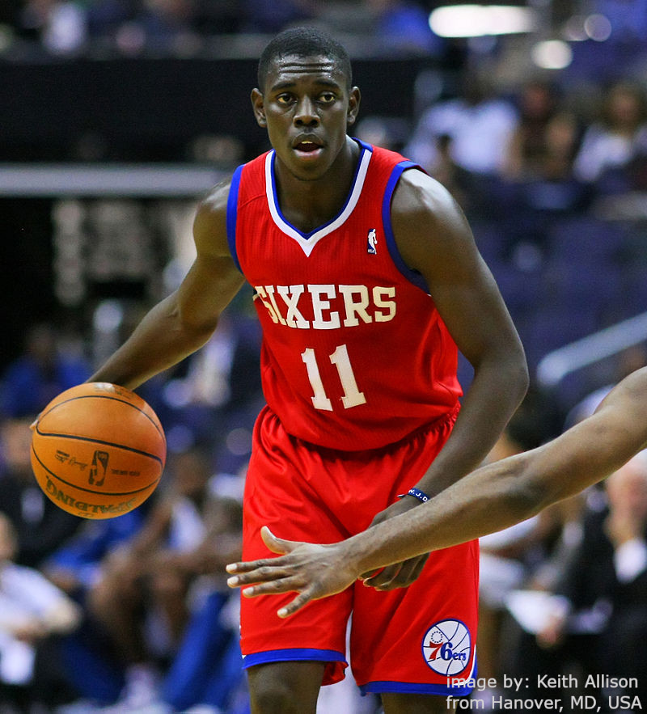
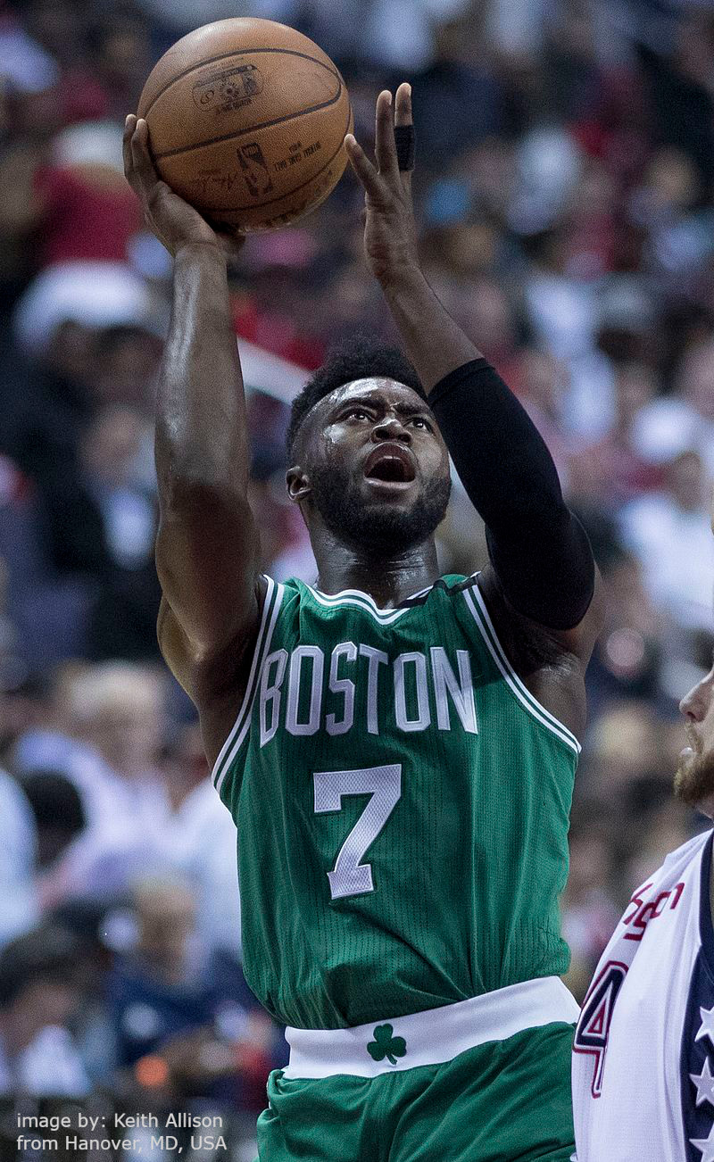
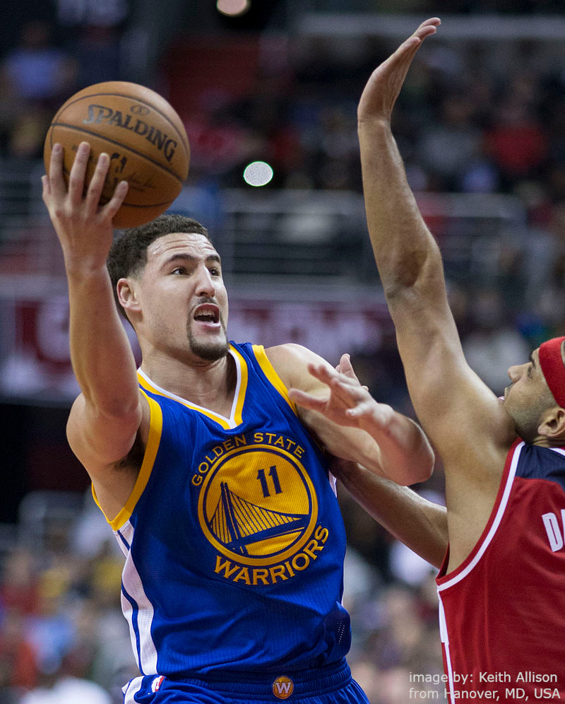
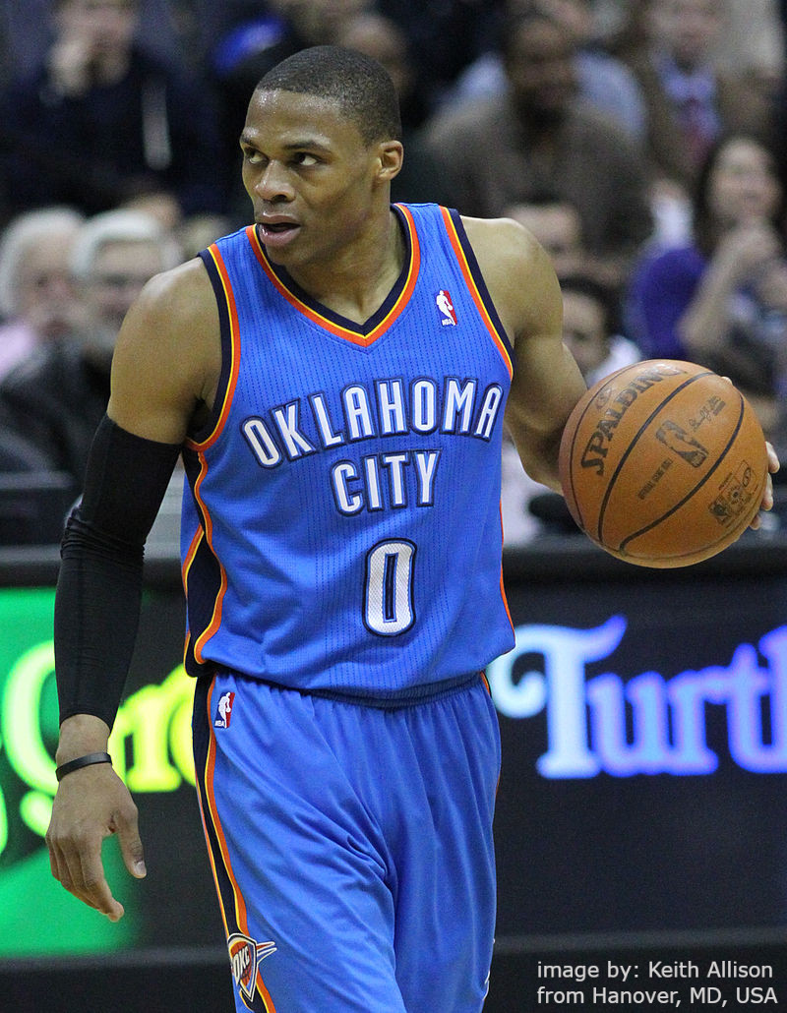
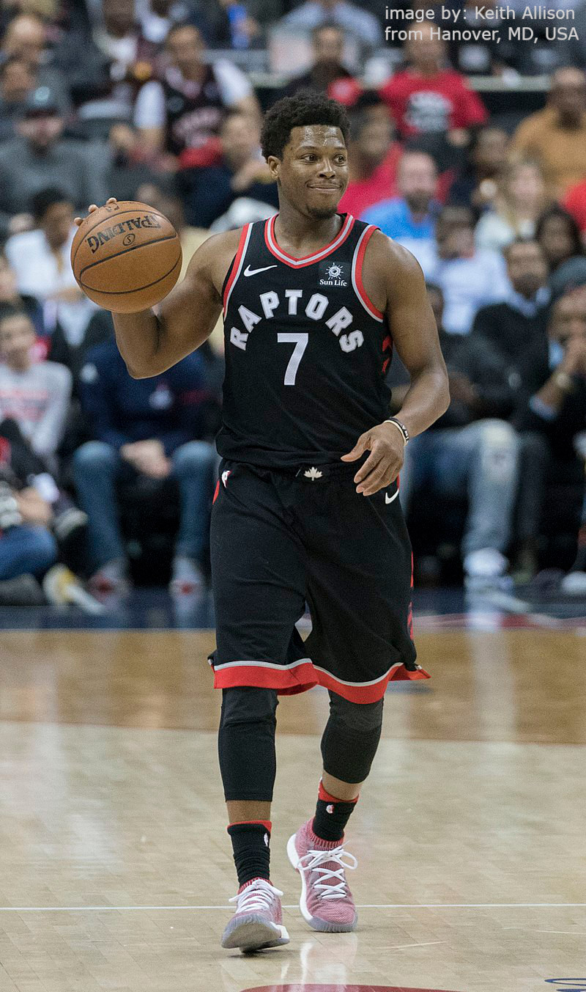
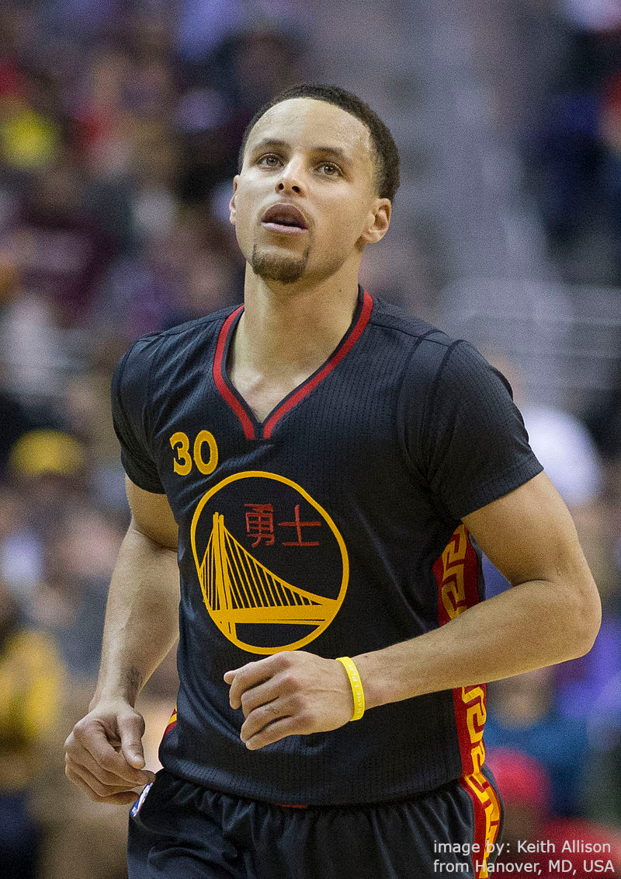
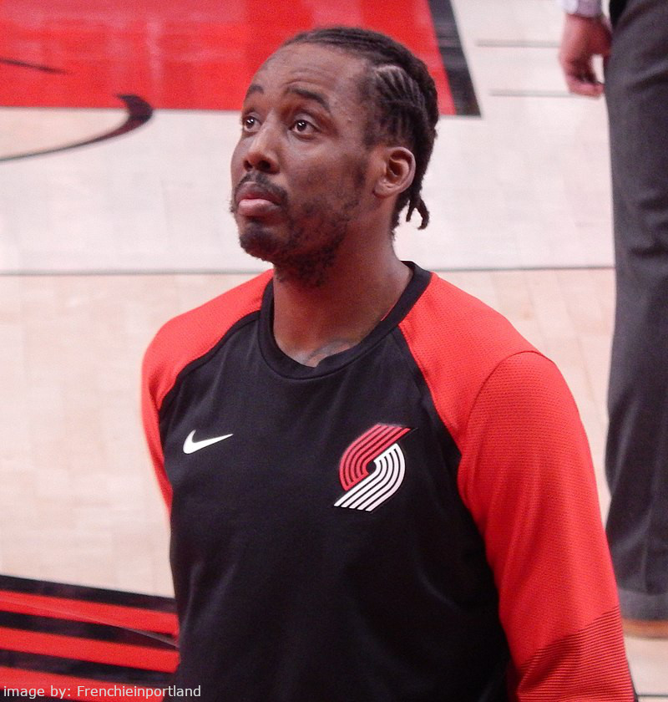
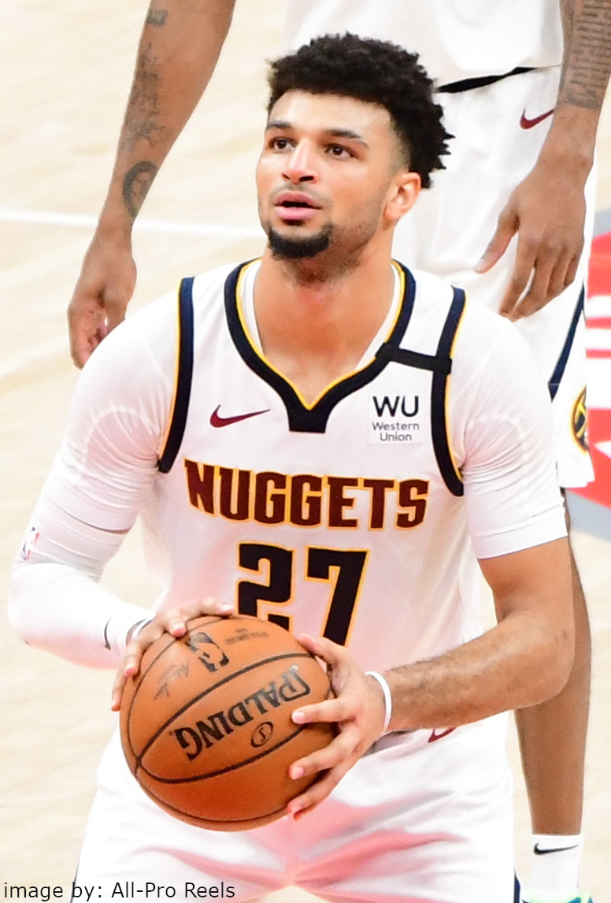
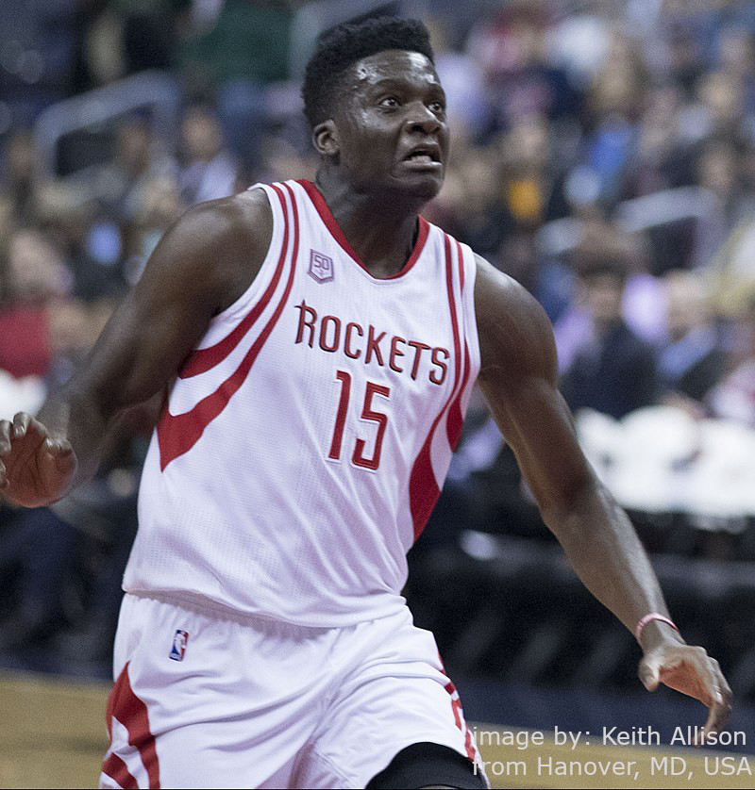
We selected real-life NBA players…

Slide 12

And extracted millions of tweets, related to them…

Slide 13



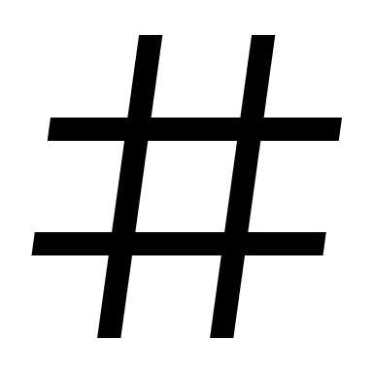




…to inspect whether the tweets posted 24h before a game have this influence on a player

Slide 14
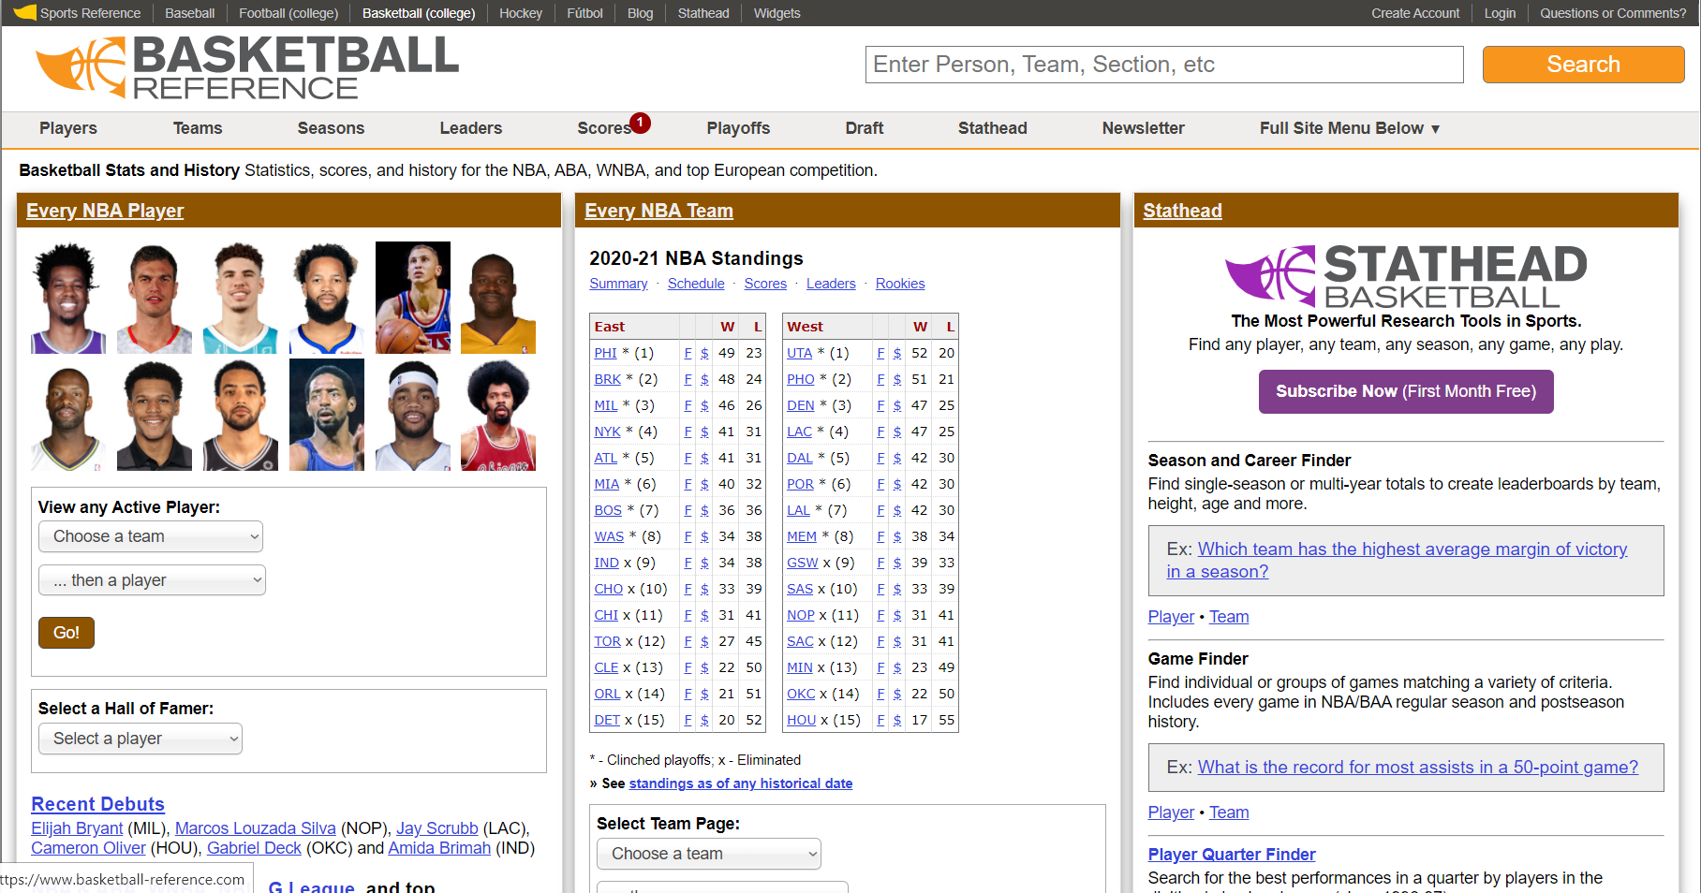

For this purpose we extracted loads of statistical NBA data from www.basketball-reference.com and merged it into our desired output…

Slide 15

Also the twitter data needed to be treated…

Slide 16
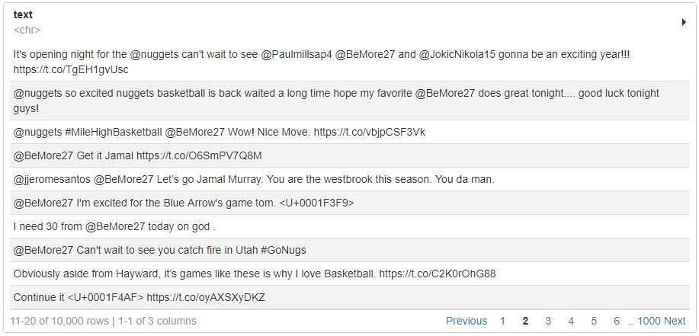
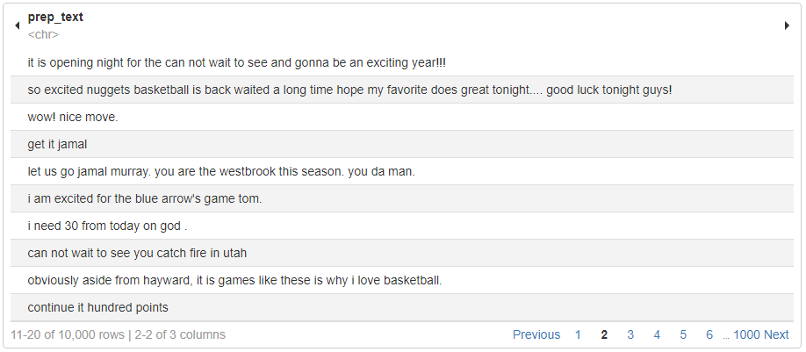

Therefore we preprocessed the tweets, obtained from the Twitter API, to make them machine-readable and to remove irrelevant content…
Raw data
Preprocessed data

Slide 17
Then we ran several sentiment analyses over the preprocessed twitter data to receive the attitudes of each post…
Jockers-Rinker
bing
syuzhet
NRC
AFINN
Novak emoji analysis

Slide 18
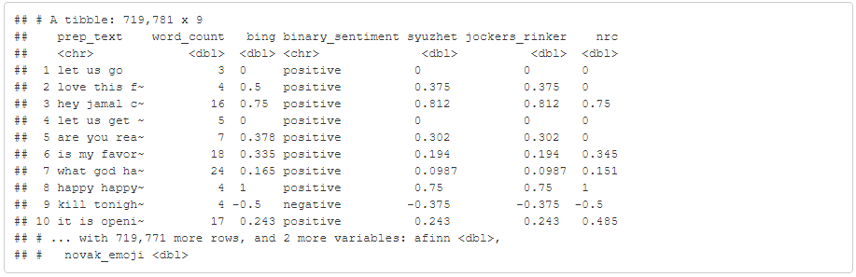
These analyzers created for each single game day and player a score of attitude that expresses, whether the tweets transport mainly positive or negative emotions

Slide 19
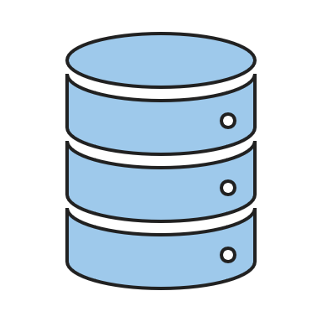
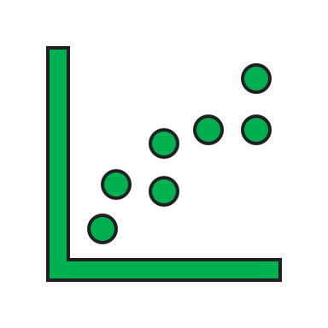


Player data
Twitter sentiments
Now we were finally able to make our analyses on these two datasets!

Slide 20

First of all, we examined our main research question…

Slide 21
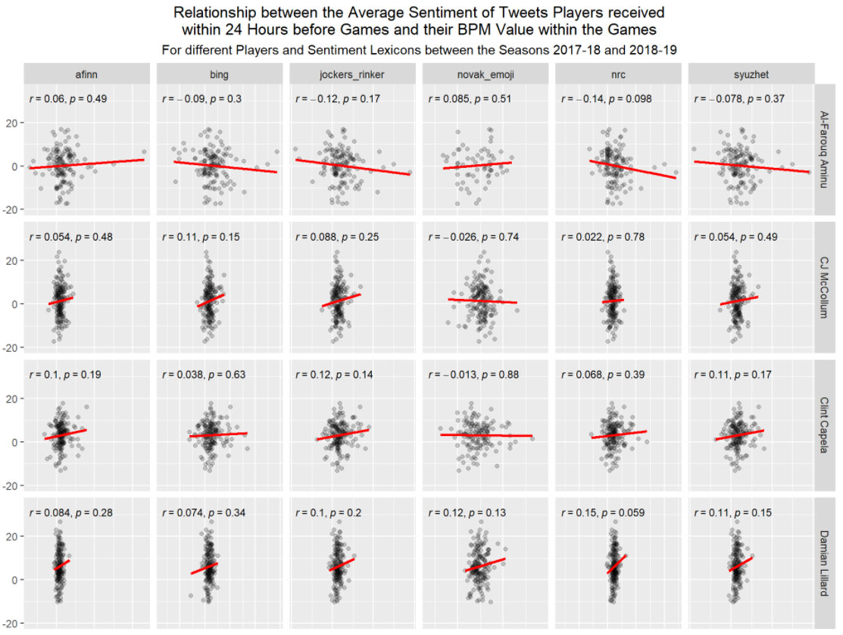
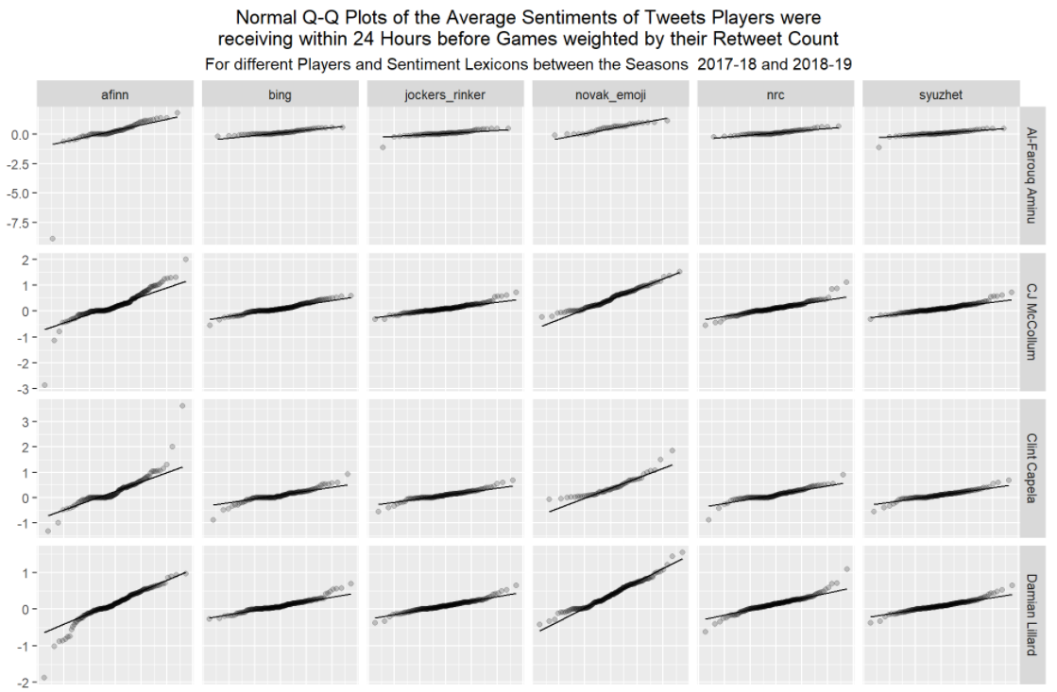
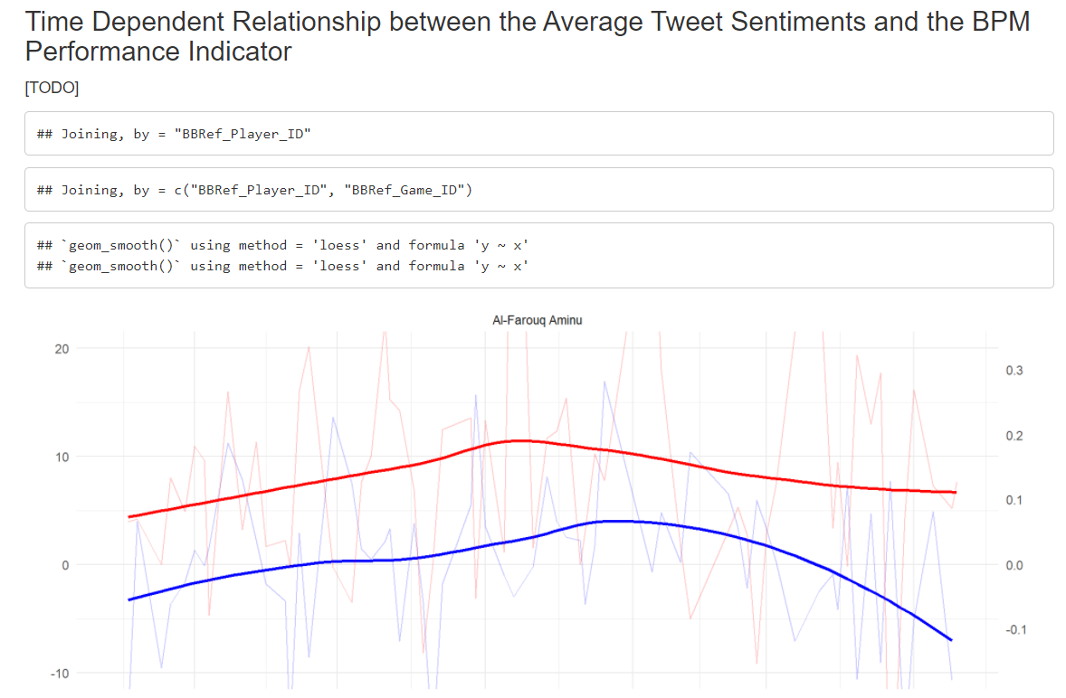
… and ran a correlation analysis between the variables of on-court performance and the tweets sentiment on the resp. game day

Slide 22
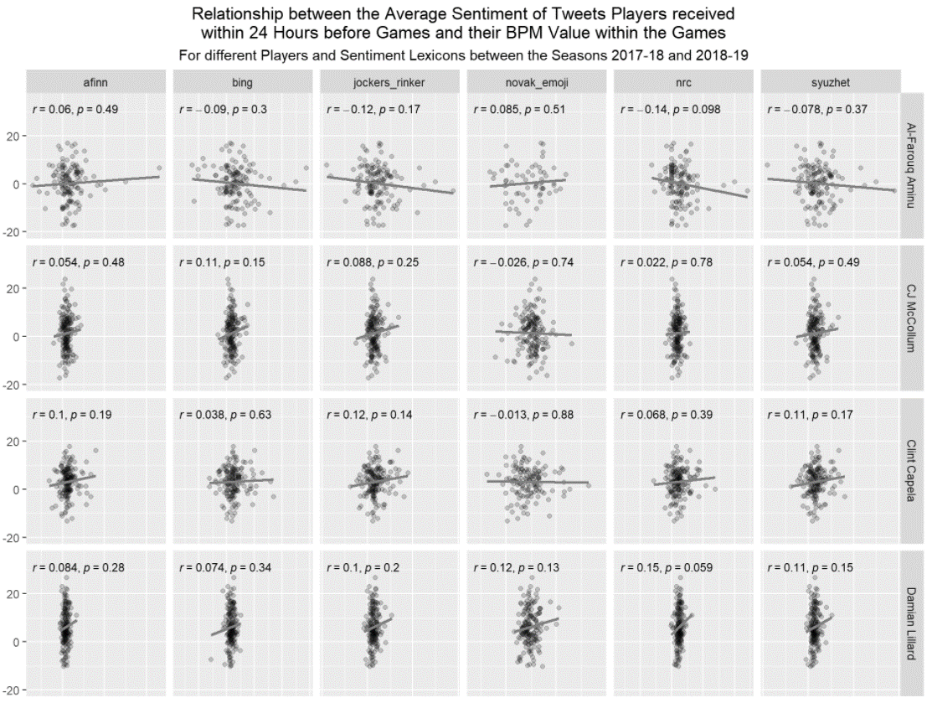

No evidence of significant correlation found… ☹

Slide 23
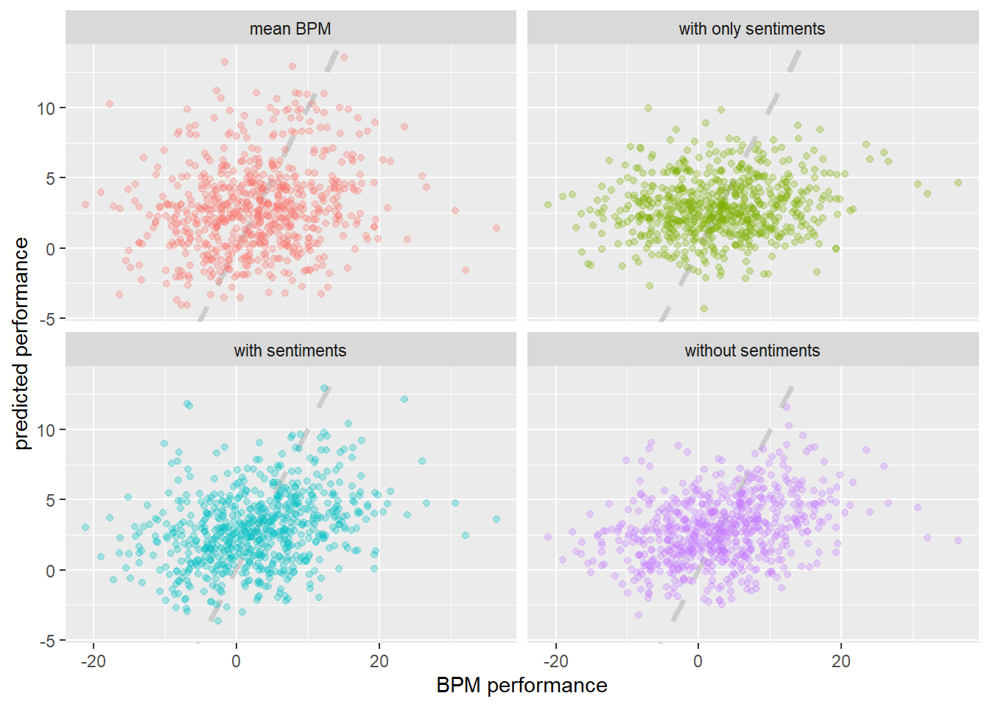
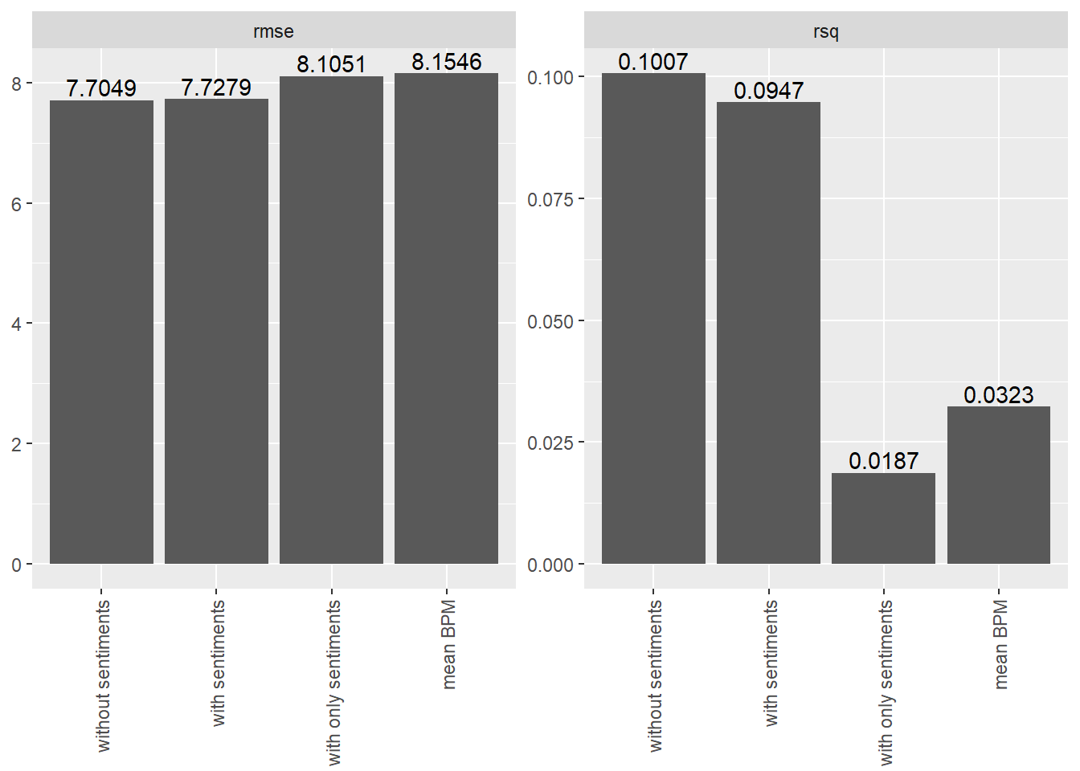
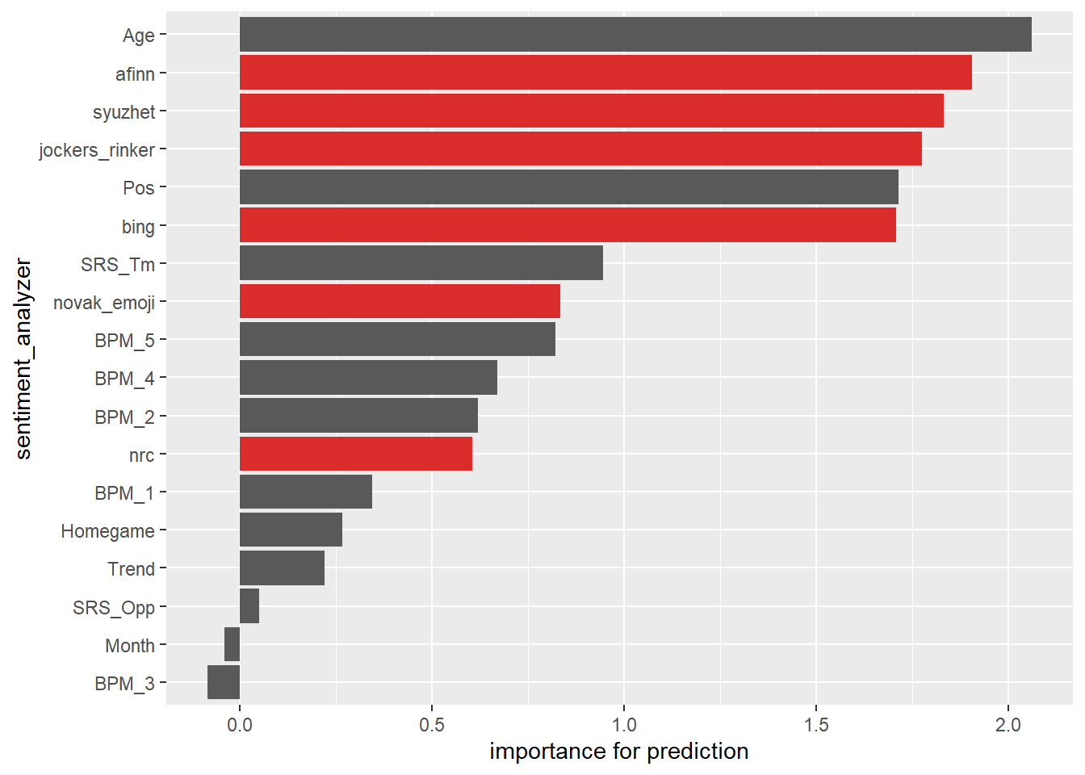
Then we tried to investigate our findings with various other analyses, e.g. a predictor that should indicate the influence of the tweets on a performance prediction

Slide 24
To gain more insights into our work and the results, just follow the link and have a look into our notebook!
https://datascirnba.netlify.app/
Sound effects & music obtained from https://www.zapsplat.com

